Slide 1
NE 591: Advanced Reactor Materials
Fall 2021
Dr. Benjamin Beeler

Slide 2
Carbides and nitrides

Slide 3
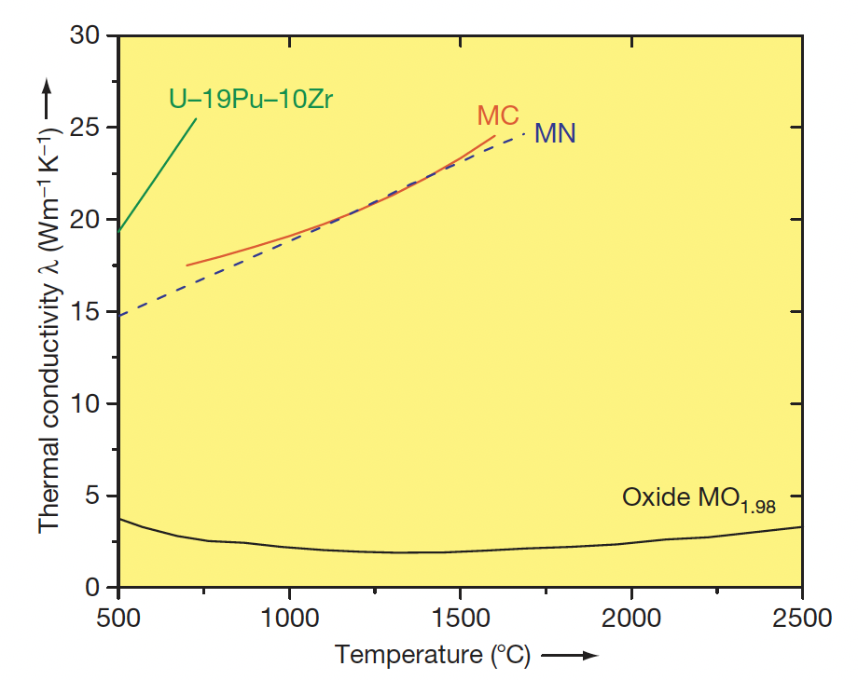
Why Carbides?
Possible fuel compositions with higher fissile atom density are nonoxide ceramics, for example, uranium–plutonium-mixed carbide or nitride
These fuels have higher thermal conductivity high fissile heavy-atom density, and a reasonably high melting point compared to metallic fuel
The higher thermal conductivity of carbide fuel and high melting point makes carbide fuel suitable for operation at high power

Slide 4
Why Carbides?
The more efficient heat transfer also allows for the possibility of large diameter fuel pins, with more fissile material per pin, and more power generation
High-specific-power operation permits fewer pins, compared to oxide, and a more compact core, which can reduce plant costs
A large amount of development work on carbide and nitride fuels was performed from 1960 to 1970, and more than 5000 advanced fuel pins have been fabricated and irradiated
The practical difficulty of fabrication of carbide fuel hampered carbide development
The high-purity inert cover gas required for fuel fabrication was expensive and maintenance of C/M ratio was difficult

Slide 5
Carbide Reactor
The Indian FBR program, however, started with the introduction of plutonium-rich mixed uranium–plutonium carbide as the driver fuel for 40MWth loop-type fast breeder test reactor (FBTR)
The reactor became critical in the year 1985 and it is the only reactor operative on a full core of carbide fuel
Carbide fuel cannot be used in LWR because of its incompatibility with the coolant
However, it can be safely used with liquid metal (Na or lead) or gas cooled (CO2 or He) in Gen-IV type of high-temperature reactor
Carbide fuel has a breeding ratio of at least 1.30, a doubling time of 15 years or less, and the burnup limit of more than 15 at.%

Slide 6
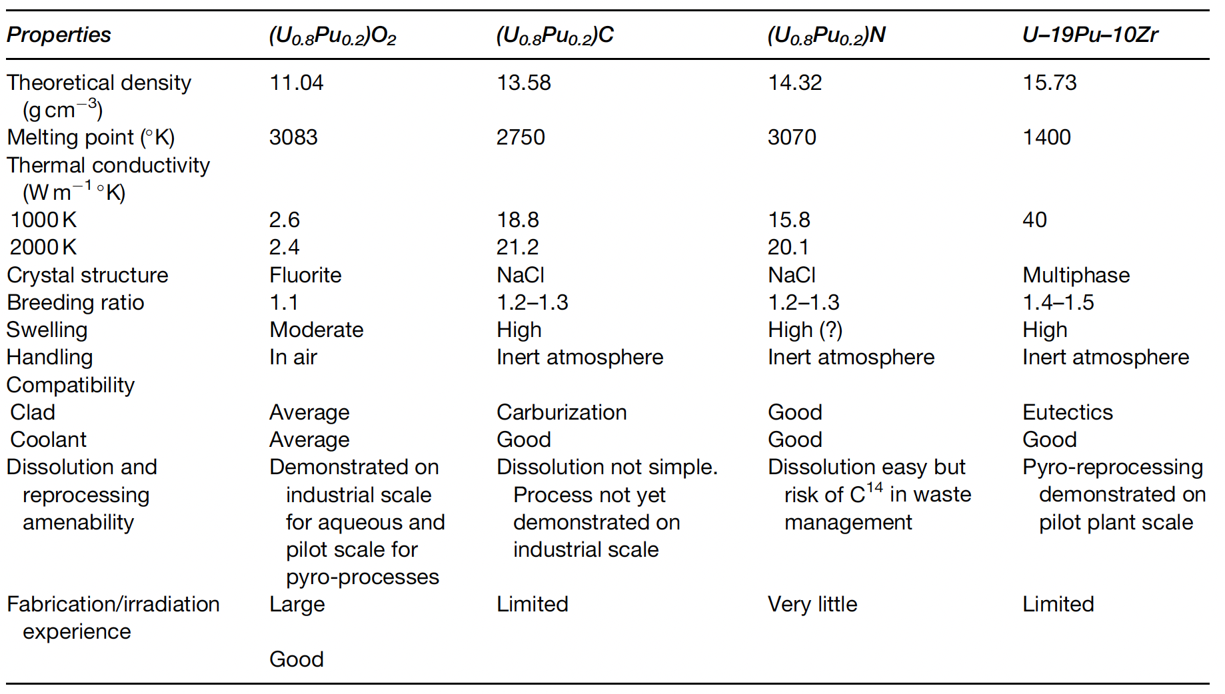
US Interest in Carbide Fuels
Following the oil crisis in 1974, a national advanced liquid-metal-cooled fast breeder reactor (LMFBR) fuels development program was initiated that built upon early years of carbide fuel development
Both carbide and nitride fuels offer a middle ground for LMFBR performance because of their higher thermal conductivity, fissile-atom density, and chemical compatibility with liquid sodium, and much higher melting point than metallic fuels

Slide 7
Carbide Pin Designs
There are two concepts available for the carbide fuel pin depending upon the type of bond between the fuel pellet and the cladding material: He-bonded and Na-bonded carbide fuels
The average operating fuel temperature of the He-bonded pin is high because of low thermal conductivity of the He bond compared to the Na bond
This design requires a larger fuel–clad gap and 85% smear density to accommodate the swelling of the fuel
The fission gas release in a He-bonded pin will be higher compared to that from a sodium-bonded pin, due to the higher temperatures
Na-bonded carbide fuel pins also require a reduced smear density compared to oxide fuels to account for fuel swelling
The purity of the Na bond is very important, requiring strict tolerances on O content

Slide 8
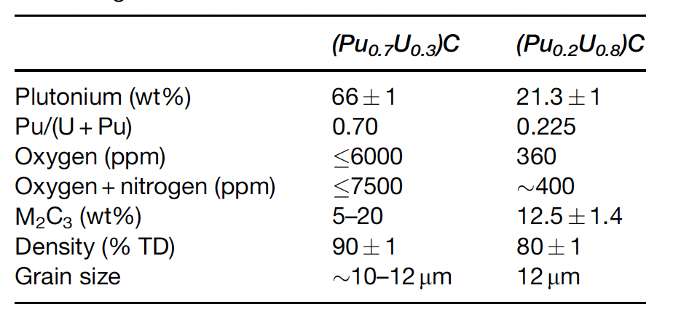
Carbide Fuel Details
A hyperstoichiometric (C/M>1, carbon to metal ratio) fuel composition is chosen so that it contains some amount of sesquicarbide M2C3 phase (M=U+Pu), which accounts for the decrease in (C/M) ratio with burnup
A sufficiently low C/M ratio may result in the formation of actinide metal phases, which may form low-melting eutectic with the cladding and limit the life of the fuel pin
FCMI can potentially exist, depending upon the operating temperature of the fuel
O and N impurities play important roles, as they act as ‘carbon equivalent’, which affect the carbon potential of the fuel

Slide 9
Key Properties
The thermophysical properties that are of importance and affect the fuel performance are solidus/liquidus temperature, thermal conductivity, coefficient of thermal expansion, elastic/fracture properties, creep, and hardness at ambient and at high temperatures
The solidus/liquidus temperatures along with thermal conductivity limit the fuel operating temperature in terms of linear heating rate
Thermal conductivity determines rate of heat transfer out of fuel and into the cladding
Thermal conductivity varies as a function of density, porosity (shape, size, and distribution), composition, presence of a second phase, grain size, etc.
Coefficient of thermal expansion is an important design parameter, the stresses generated in the fuel and by the fuel in the cladding are partly due to the difference in the CTE between the fuel and the cladding

Slide 10
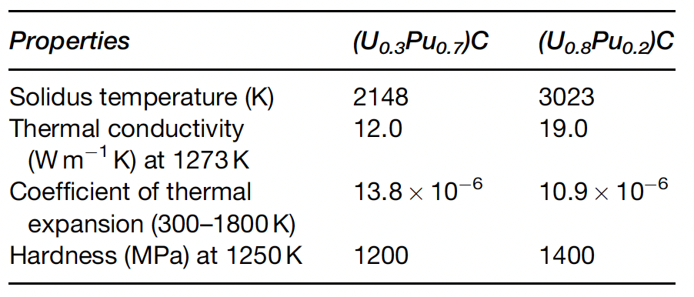
Key Properties
The elastic and fracture properties of the fuel are primarily responsible for the extent and severity of FCMI
Both thermal-induced and irradiation- induced creep of the fuel also determine the extent of FCMI
Mechanical and creep properties depend on composition, second phases, grain size, etc.
Pu lowers melting point, decreases thermal conductivity, increases expansion, and soften the fuel

Slide 11
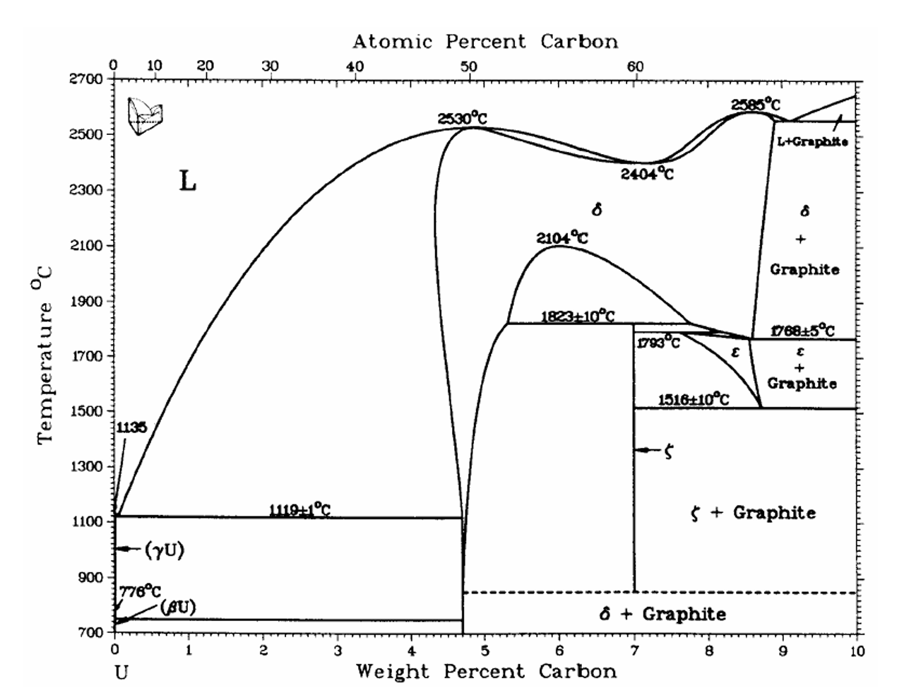
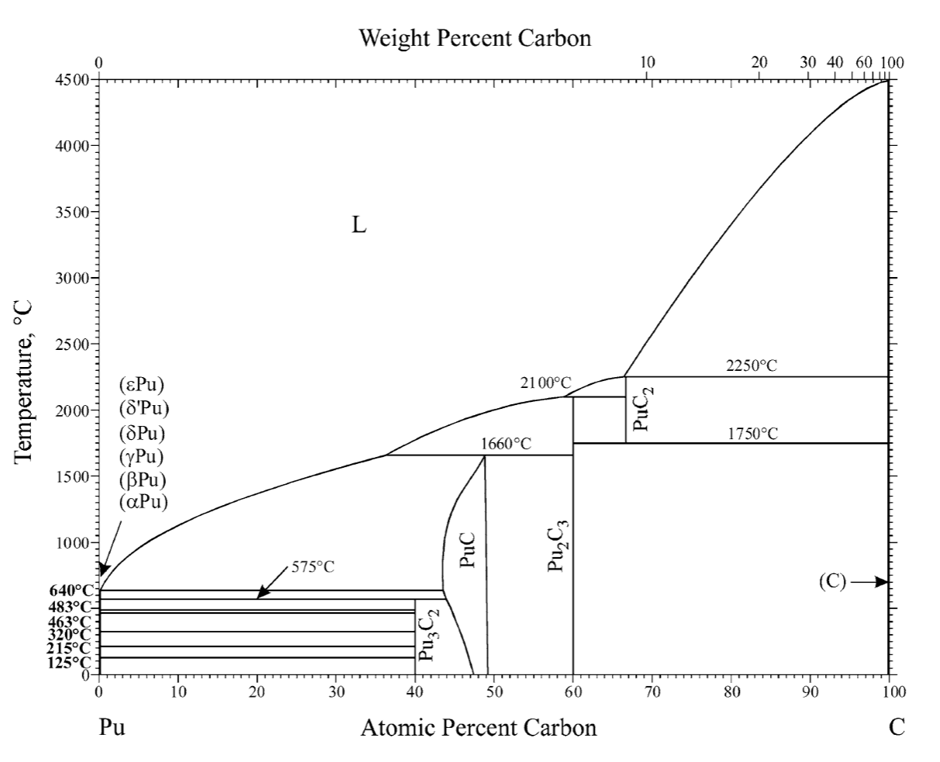
Phase Diagrams of Carbides

Slide 12
U/Pu-C Chemistry
Uranium forms three compounds with carbon: UC, U2C3, and UC2
U2C3 has a fixed stoichiometry (is a line compound)
UC is stable over a wide temperature and composition range, with a melting point of ~2800 K
UC2 is stable in two phases, alpha-UC2 and beta-UC2
U2C3 decomposes into UC+alpha-UC2 on heating from 2096 to 2110K and into UC+C below 1400 K
The Pu–C system has four compounds: Pu3C2, PuC1–x, Pu2C3, and PuC2
The compound Pu3C2 decomposes into Pu+PuC at 848 K
The differences in the UC/PuC diagrams are mainly due to (i) the presence of Pu3C2 compound, (ii) the low stability of PuC compared to UC, and (iii) the high stability of Pu2C3 compared to U2C3

